Slide 1
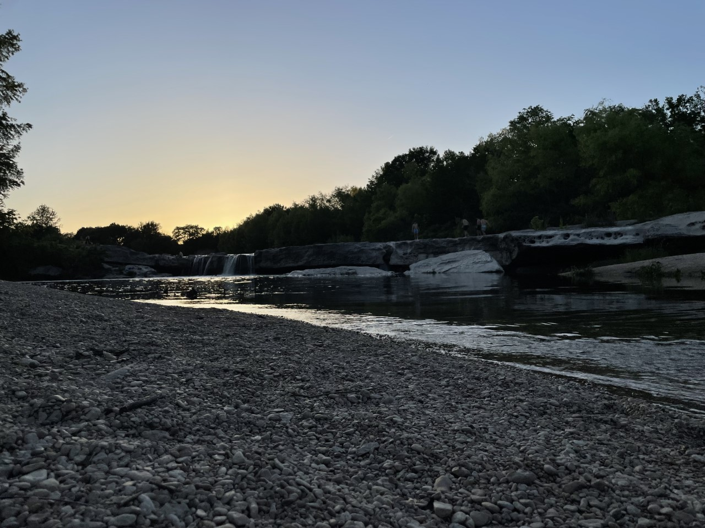
Home Research Projects
Life Things
Elisa Koolman
The University of Texas at Austin
I am a second-year Mechanical Engineering Ph. D. student at the University of Texas at Austin in the Center for Engineering Education. My goal in my research is to take an intersectional lens to investigate barriers in engineering education. I also bring this mindset into research on university makerspaces and teaching tools.
I earned my B.S. in Mechanical Engineering from the Georgia Institute of Technology. While there, I worked on a validation study for a teaching tool in the EDRL.
I also enjoy baking, gardening, and fiber arts.
Research interests: design thinking, higher education in engineering, barriers in STEM
Link to LinkedIn, Instagram, email, ME building mailing address
Scroll Down button
Download my CV!

Slide 2
News
Blog
End of page stuff

Slide 3
Home Research Projects
Baking Art
Projects
Publications
Speaking Events
University Makerspaces
Authentic Learning Assignment in Fluid Mechanics Course
[citation for ASEE conf paper]
ASEE 2023 Mechanical Engineering Poster session
Barriers for Disabled students in STEM
Generative Design Thinking Teaching Tool in undergraduate engineering

Slide 4
Home Research Projects
Life Things
Baking
Gardening
Cats!
Music
Fiber arts

